Slide 2


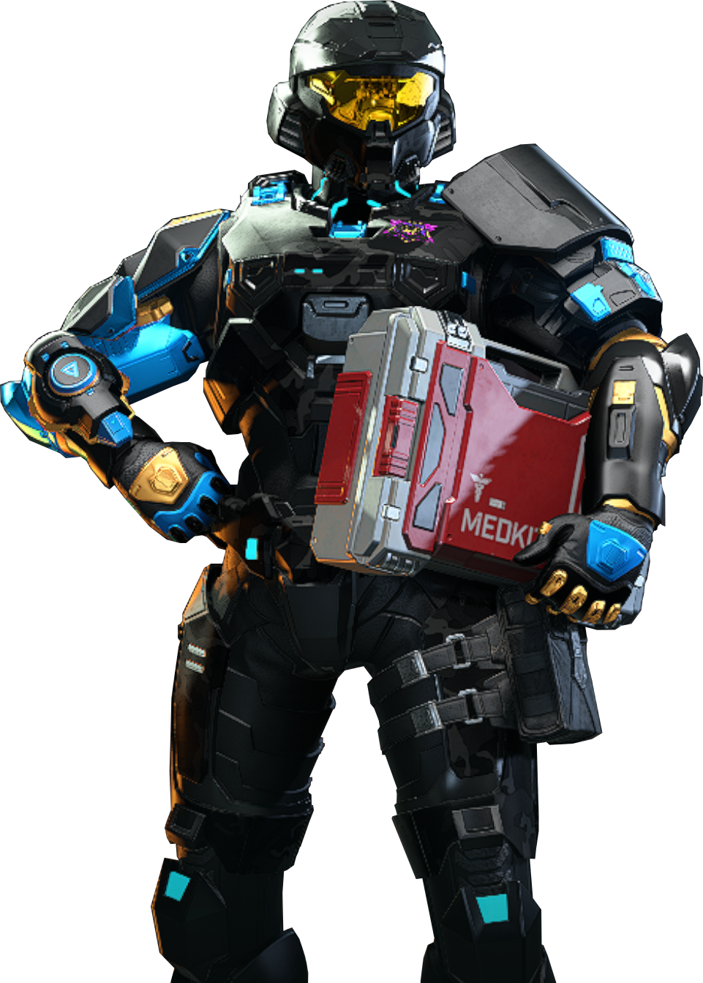


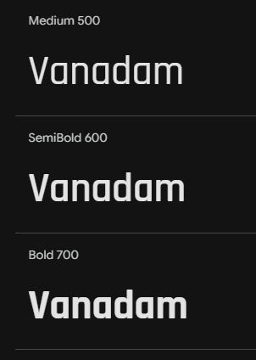
Colour Swatches
#2B2E2E
#96989E
https://fonts.google.com/specimen/Rajdhani?query=Rajdhani&preview.text=Halo%20Infinite

Slide 3
Navigation
Current Season / Counter
Esports News
Article Carousel (featured blog)
Map 1
Map 2
Map 3
Map 4
Map 5
Map 6
Map 7
Map 8
Blog

Slide 4
Navigation
Current Season / Counter
Map
Article Carousel (featured blog)
Map
Map
Map
Map
Map
Map
News
Map
?

Slide 5
Navigation
Current Season / Counter
Article Carousel (featured blog)
News
?

